Slide 1
Master of Information Technology and Analytics Program
(MITA)

Slide 2
Directors: Dr. Vijay Atluri
Dr. Farid Alizadeh
Administrative Coordinator: Kelly Terry
Student Advisor: Dr. Wajahat Gilani
Admission Coordinator : Yulissa Ortiz
Career Counselor: Purvi Kapuriya

Slide 3
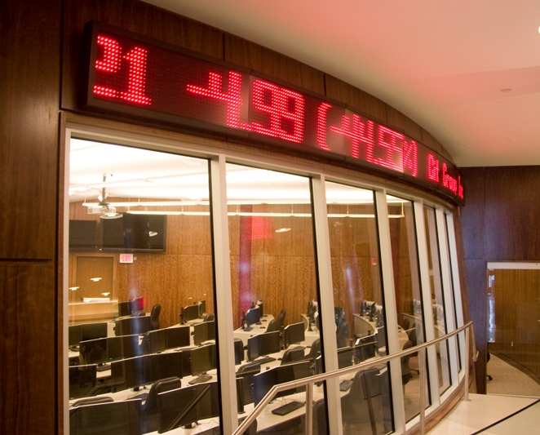
Program Location
Main Campus
Newark
1 Washington Park

Slide 4
MITA program history
Started the program in 2008
Administered by the MSIS department
Dept Faculty http://www.business.rutgers.edu/msis/faculty
Enrollment
2012-2013, 17 students
2013-2014, 21 students
2014-2015, 41 students
2015-2016, 102 students
2016-2017, 274 students
2017-2018, 343 students
2018-2019, 389 students
2019-2020, 391 students
2020-2021, 88 students
Fall 2021
Over 390 applications were received
91 new students enrolled
Spring 2022
114 applications
28 new students

Slide 5
Why Master of Information Technology and Analytics?
Bridge the gap between IT and Business
Technical & Domain based
Software development projects
Design/analysis/implementation
If your main interest is management, consider a MBA
Concentrations
Operations Research & Business Analytics
Data Science and Machine Learning
Cyber Security

Slide 6
Full-time or Part-time
30 Credits (10 courses)
Daytime classes and some evening classes
Newark campus program and some classes offered at the New Brunswick campus
12 credits per semester (4 courses) for FT status
Can finish degree in 2 semesters but most opt to finish in 3 semesters

Slide 7
Curriculum Requirements
30 Credits
10 courses include
- 3 foundation courses - 3 concentration courses - 4 elective courses

Slide 8
Foundation Courses
Choose any 3 of the following 4
22:544:643 Information Security
22:544:603 Business Data Management
22:544:641 Analytics for Business Intelligence (or 22:544:650 Data Mining)
22:544:613 Introduction to Data Structures and Algorithms or 16:198:512 - Introduction to Data Structures and Algorithms

Slide 9
Concentrations
Operations Research and Business Analytics
26:711:651 Linear Programming
26:711:652 Nonlinear Programming
26:711:653 Discrete Optimization
26:960:575 Introduction to Probability
26:960:580 Stochastic Processes
Cyber Security
22:544:643 Information Security
26:198:645 Data Privacy
22:544:605 Introduction to Software Development
22:544:640 Fundamentals of Blockchain and Distributed Ledgers
Data Science and Machine Learning
26:198:642 Multimedia Information Systems
22:544:605 Introduction to Software Development
26:198:641 Advanced Database
22:198:646 Data Analysis and Visualization
22:544:631 Algorithmic Machine Learning
22:544:635 Neural Networks and Deep Learning
22:544:634 Optimization Methods for Machine Learning
22:544:637 Reinforcement Learning

Slide 10
Elective Courses
Ph.D. level courses:
26:711:651 Linear Programming
26:711:652 Nonlinear Programming
26:711:653 Discrete Optimization
26:960:575 Introduction to Probability
26:960:580 Stochastic Processes
26:198:622 Machine Learning
26:198:641 Advanced Database Systems
26:198:642 Multimedia Information Systems
26:198:643 Information Security
26:198:645 Data Privacy
26:198:685 Special Topics in Information Systems
Applications of Machine Learning to Big Data
Big Data: Management, Analysis, and Applications
Data-Intensive Analytics
26:711:555 Stochastic Programming
26:711:557 Dynamic Programming
26:711:685 Special Topics in Operations Research/Management Science
26:960:576 Financial Time Series
26:960:577 Introduction to Statistical Linear Models
Dynamic Pricing and Revenue Management
Masters level courses:
22:544:688 MIT Capstone Project*
22:544:605 Introduction to Software Development
22:544:608 Business Forecasting
22:544:638 MITA Internship (0 credits)
22:544:646 Data Analysis & Visualization
22:544:660 Business Analytics Programming
22:544:670 Information Technology Strategy
22:799:659 Supply Chain Solutions with ERP/SAP I
22:799:660 Supply Chain Solutions with ERP/SAP II
22:799:661 Introduction to Project Management
16:198:520 Introduction to Artificial Intelligence
22:544:653 Game Theoretic Methods for Strategic Decision Making
22:544:640 Fundamentals of Blockchain and Distributed Ledgers
22:544: 647 Graph Methods and Network Analysis
*Independent Study style course under faculty supervision

Slide 11
Academic year | Internships
2010-2011 | 2
2011-2012 | 7
2012-2013 | 6
2013-2014 | 6
2014-2015 | 11
2015-2016 | 30
2016-2017 | 78
2017-2018 | 135
2018-2019 | 161
2019-2020 | 159
2020-2021 | 18

Slide 12
Recent Internships
IBM
Sprint
Marlabs Inc.
WebMD
Nokia
Barclays
Panasonic
Samsung
PWC
Goya Foods
Dow Jones
Merck
Morgan Stanley
Pfizer
Qualcomm Technologies
ADP
Hewlett Packard
New York Life
Cognizant
Tata Consultancy Services
NJ Transit
Wiss

Slide 13
Academic year | Graduated | Currently Employed In the US
2009-2010 | 7 | 7
2010-2011 | 2 | 2
2011-2012 | 12 | 10
2012-2013 | 10 | 7
2013-2014 | 21 | 15
2014-2015 | 27 | 19
2015-2016 | 41 | 33
2016-2017 | 102 | 78
2017-2018 | 163 | 147
2018-2019 | 191 | 171
2019-2020 | 204 | 180
2020-2021 | 189 | 119

Slide 14
Recent Outcome
Digital Analytics Specialist at Benjamin Moore in Montvale, NJ
Business Analysis at UPS in Paramus, NJ
Programmer Analyst at Express Scripts Inc. in Franklin Lakes, NJ
Data Research Associate at John Wiley & Sons in Hoboken, NJ
Consultant at Infosys in San Francisco, CA
Data Enablement Associate at KPMG in New York, NY
Business Analyst at IBM in Armonk, NY
Technology Analyst at Barclays Capital in New York, NY
Senior System Engineer at AT&T in El Segundo, CA
Data Scientist Digital Analytics at Verizon in Basking Ridge, NJ
Data Engineer at Amazon in Seattle, WA
Big Data Engineer at Capital One, NJ
Software engineer at Amazon, Seattle
Data Analyst at SAP AMERICA, Philadelphia ,PA
Technical Product Manager at Mastercard, NY
Java Application Specialist at Insight Global, Atlanta
Audit Associate, RSM, US LLP , NJ
Software dev , Intuit, CA
Data Scientist at IBM in Ann Arbor, MI
Senior Associate at HighPoint Solutions Inc. in Parsippany, NJ
Audit Data Analyst at Deloitte in New York, NY
IT Engineer-Analytics at Hewlett Packard in Santa Clara, CA
Big Data Developer at UBS in Weehawken, NJ
Sr. Associate in Global Mobility at PwC in Florham Park, NJ
Senior Associate, Risk Assurance - Advisory Services at Ernst & Young in New York, NY
System Analyst at Cognizant Technology Solutions in Parsippany, NJ
Business Analyst at Morgan Stanley in New York, NY
Input/Output Analyst-Project Manager at ADP in Roseland, NJ
SEO Data Analyst at Dow Jones , NYC
Software Engineer at Wayfair, Boston
Tableau Dev at UseReady, NYC
Ecommerce Data Analyst at Spikeball Inc., Chicago
Project Manager at Goldman Sachs, NYC

Slide 16
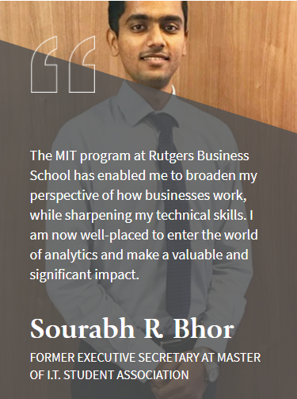
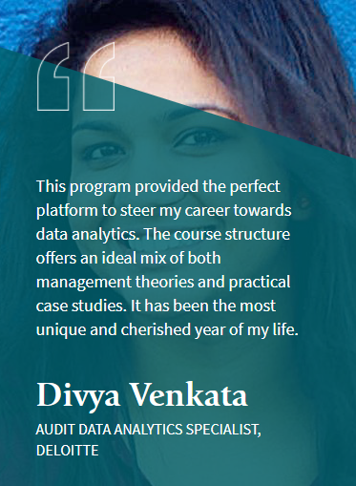
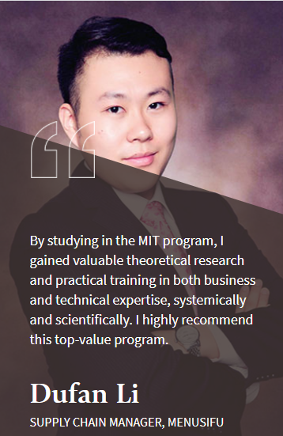
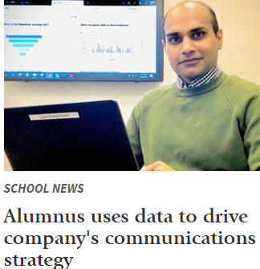
Some of our RBS MITA alumni’s experiences…
How it has impacted their career trajectories.

Slide 17
Application Deadlines
Semester Date(s)
Fall May 1st
Spring October 15

Slide 18
On-Line Application
On-line Application site:
http://www.business.rutgers.edu/mit/admissions

Slide 19
Application Documents
Application and Fee (currently $70)
Personal Statement
Resume
Copy of transcript(s)
Two letters of recommendation
GMAT or GRE
TOEFL or IELTS (if applicable)
Financial Documents (international students only)

Slide 20
Application Documents for Accelerated MITA (Rutgers MIS or BAIT major)
At least 75 credit hours of undergraduate coursework must be completed before you can apply
Typically, apply no earlier than the 2nd half of their junior year
Application and Fee (currently $70) - Waived
Personal Statement
Resume
Copy of transcript(s)
Two letters of recommendation - Waived
GMAT or GRE - Waived
TOEFL or IELTS (if applicable) – N/A
Financial Documents (international students only)
Minimum GPA 3.0 cumulative, 3.5 Major

Slide 21
Application Documents for Accelerated MITA
Will be given the option to substitute up to 6 undergraduate BAIT or MIS credits with 6 MITA graduate credits
Subject to approval of the MSIS department chair and the MITA program directors
Some course replacement possibilities:
22:544:603 Business Data Management (MIT) may replace 33:136:470 Business Data Management (BAIT) / 29:623:319 Database Management Systems for Business Applications (MIS)
22:544:641 Analytics for Business Intelligence (MIT) may replace 33:136:494 Data Mining for Business Intelligence (BAIT) / 29:623:335 Data Warehousing and Data Mining (MIS)
22:544:643 Information Security (MIT) may replace 33:136:471 Information System Security (BAIT) / 29:623:345 Cyber Security (MIS)
22:544:605 Introduction to Software Development (MIT) may replace 33:136:388 Foundations of Business Programming (BAIT) / 29:623:350 Structured Programming Applications (MIS)
https://www.business.rutgers.edu/dual-degree/accelerated-information-technology-analytics

Slide 22
Getting Admitted
Admission rate is around 40%.
Admitted and Enroll 180 - 200 students a year (pre-COVID)
Test score averages
Average GMAT 556
Average GRE 306 (147 in verbal and 159 in quantitative)
Most admitted students have undergraduate degrees in Information Technology, Computer Science, Industrial Engineering, Business Analytics and other related fields.

Slide 23
Current Tuition Rates
12 credits Tuition/term(semester) Fees*/term(semester)
NJ Resident $13,416.00 $1,464.50
Non-NJ Resident and International $18,924.00 $1,464.50
Per Credit
NJ Resident $1,118.00 $494.50 + Computer Fee
Non-NJ Resident and International $1,577.00 $494.50 + Computer Fee
*International Students are charged Health Insurance Premiums of $1,025.50 for full-time students. International Students are also charged a $250.00 Sevis Administration Fee for F1 and J1 visa holders. Computer Fees range from $88.50 to $171.00.

Slide 24
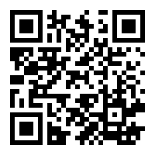
MITA Web Page
https://www.business.rutgers.edu/mita

Slide 25
Thank you!
Questions?

